Slide 1
教育部跨領域教師發展暨人才培育計畫
110.03 版
Course Design of Interdisciplinary Workshop .
hands-on practice
Lecturer
Welcome to use, please cite the source from design-thinking.tw. Licensed under the Creative Commons Attribution-NonCommercial-ShareAlike 3.0 Taiwan License.
Notes:
The font is "PingFang TC."

Slide 2
How to balance professionalism and creativity? How to collaborate across disciplines? How to apply design thinking? How to innovate in entrepreneurship?
Interdisciplinary Microcredit Workshop.
In the form of a workshop: The flexibility in timing and content will not compromise the integrity of the original curriculum.
Simulating an entrepreneurial environment: Addressing authentic problems by collaborating with cross-disciplinary teams to implement solutions.

Slide 3
What is interdisciplinary?
What is interdisciplinary teaching?

Slide 4
跨領域
Multidisciplinary
Interdisciplinary
Transdisciplinary
Notes:
There are three forms included in interdisciplinary approaches.

Slide 5
Notes:
Higher education's approach to talent development is like a fruit stand (multidisciplinary), while the purpose of the dual-day workshop is to cultivate interdisciplinary talents with cross-disciplinary teaching and peer interaction, hoping that students can further enhance their achievements beyond professional boundaries (transdisciplinary) by integrating expertise from different fields.

Slide 6
Real-world problems are not addressable by a single discipline alone.

Slide 7
Interdisciplinarity and Design Thinking.
Design Thinking emphasizes a "broad" creative space for solutions. When students and teachers from multiple disciplines participate together, solutions often emerge within the realm of interdisciplinary, cteating more profound design solutions.
Real-world problems
Single-discipline creative pathways.
For example：
when the theme is "Mobility for the Elderly," traditional disciplines like engineering, psychology, and healthcare may provide "specialized" solutions, often constrained by existing knowledge frameworks.
The ideal process of "Design Thinking" involves a cross-disciplinary team that integrates expertise from different fields to generate innovative outcomes. For example, a collaborative effort between engineering, healthcare, and psychology may lead to a solution like a "personalized electric vehicle that balances dignity and safety."
Design Thinking
Interdisciplinary creative space
Field three
Field one
Field two

Slide 8
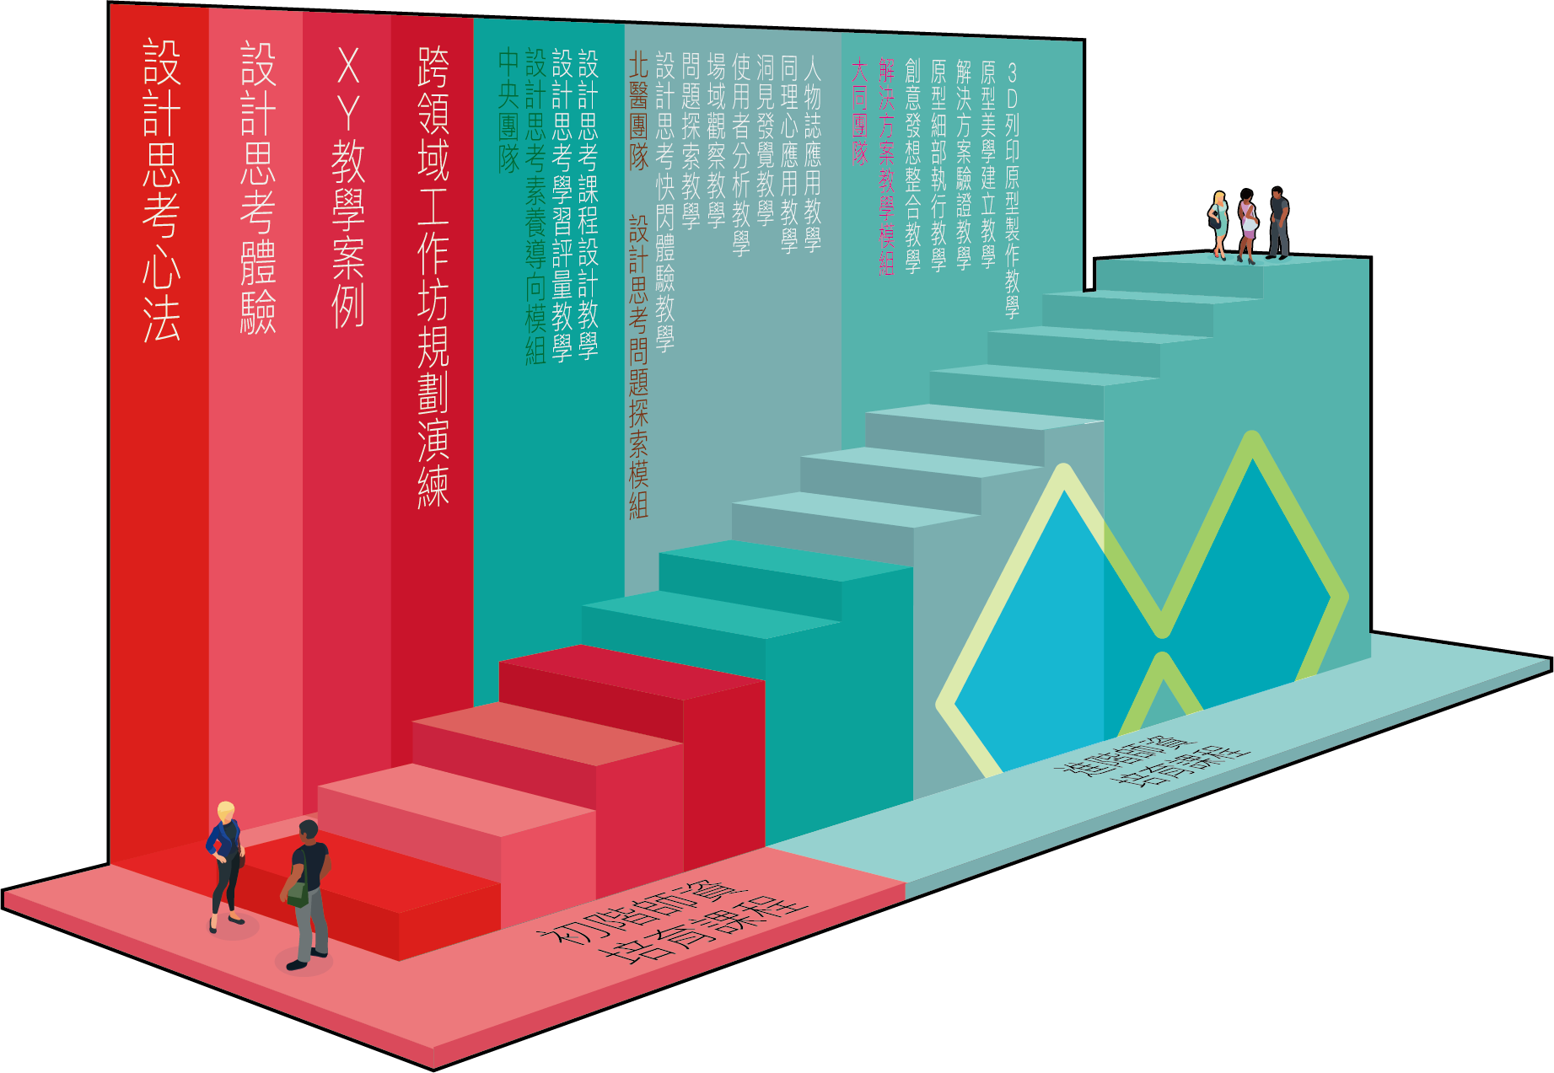
Interdisciplinary Workshop Planning Exercise
XY Teaching Case Study
Design Thinking Workshop
Design Thinking Mindset
National Central University Team
Competency-Oriented Instruction Module
Design Thinking Learning Assessment
Design Thinking Course Design
Taipei Medical University Team
Problem Exploration Instruction Module
Design Thinking Flash Experience
Problem Exploration
Field Observation
User Analysis
Insight Discovery
Empathy Application
Persona Application
Tatung University Team
Solution Instruction Module
Creative Ideation Integration
Detailed Prototype Execution
Solution Validation
Prototype Aesthetics Establishment
3D Printing Prototype Production
Advanced Teacher
Training Course
Primary Teacher
Training Course
Notes:
This introductory course mainly plays the red part in the design thinking curriculum. The main organizer currently has arrangements for advanced courses. This includes advanced teaching modules developed by the Central Team, the Taipei Medical University Team, and the Tatung Team.

Slide 9
Five steps of Design Thinking
Notes:
Stanford d.school's foundation of Design Thinking consists of five key steps.

Slide 10
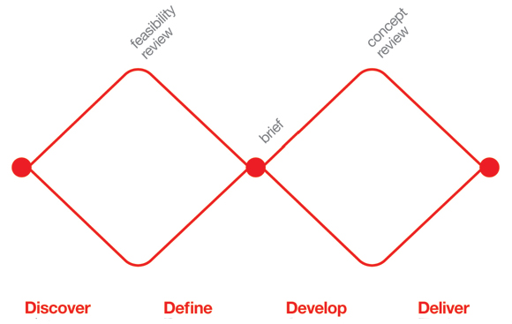
The Double Diamond design process.
What is a double diamond? Double Diamond is a design process developed by the Design Council of the United Kingdom in 2005. It is a simple and visual way to depict the design process.
Double Diamond Four Stages Indeed, the Double Diamond design process is divided into four distinct stages: Discover, Define, Develop, and Deliver. These stages reflect the divergent and convergent phases of the design process, showcasing the thinking patterns of designers.
Empathy
Define
Ideate
Prototype
Test
http://www.designcouncil.org.uk/
Notes:
The Design Council of the United Kingdom further represented the design thinking process with the visual concept of divergence and convergence in thinking.

Slide 11
The first quarter of the Double Diamond model covers the start of the project. Designers try to look at the world in a fresh way, notice new things and gather insights.
(Design Council, 2017)
Opportunity
Design Brief
Concept
Discover
Define
Develop
Deliver

Slide 12
Opportunity
Design Brief
The second quarter represents the definition stage, in which designers try to make sense of all the possibilities identified in the Discover phase. Which matters most? Which should we act on first? What is feasible? The goal here is to develop a clear creative brief that frames the fundamental design challenge.
(Design Council, 2017)
Concept
Discover
Define
Develop
Deliver

Slide 13
Opportunity
The third quarter marks a period of development where solutions or concepts are created, prototyped, tested and iterated. This process of trial and error helps designers to improve and refine their ideas.
(Design Council, 2017)
Design Brief
Concept
Discover
Define
Develop
Deliver

Slide 14
Opportunity
The final quarter of the double diamond model is the delivery stage, where the resulting project (a product, service or environment, for example) is finalised, produced and launched.
(Design Council, 2017)
Design Brief
Concept
Discover
Define
Develop
Deliver

Slide 15
Concept
Opportunity
Design Brief
divergent
convergent
divergent
convergent
EMPATHY
DEFINE
IDEATE
PROTOTYPE
TEST
Discover
Define
Develop
Deliver
Notes:
苗圃(MIAOPU) uses the Double Diamond model as a core framework for teacher training and human development, aligning it with the five steps of design thinking.

Slide 16
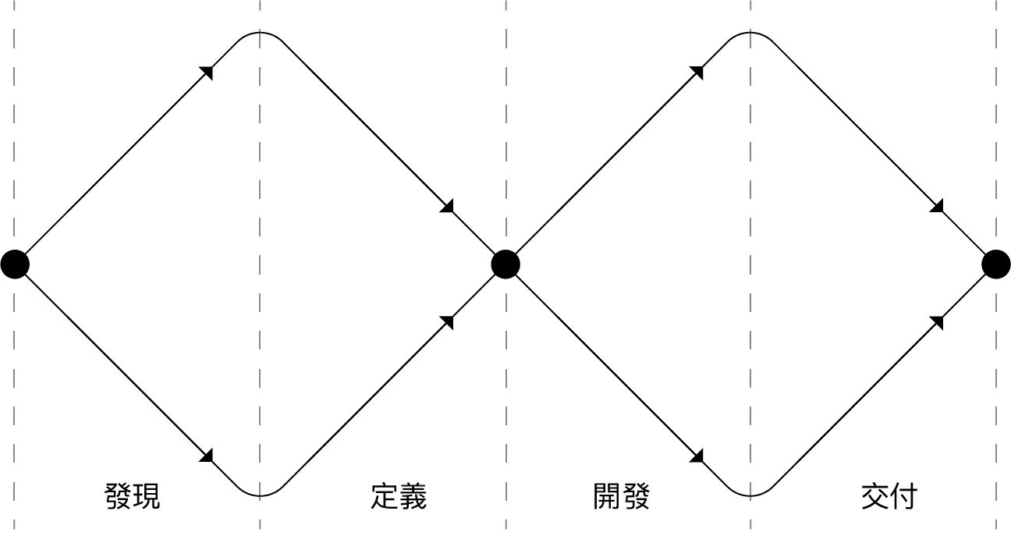
The design thinking process includes
+
EXPLORE
VERIFY
Discover
Define
Develop
Deliver
Notes:
The first diamond primarily focuses on the exploration phase before defining the problem, while the second diamond is centered around the execution and validation steps before completing the innovation.

Slide 17
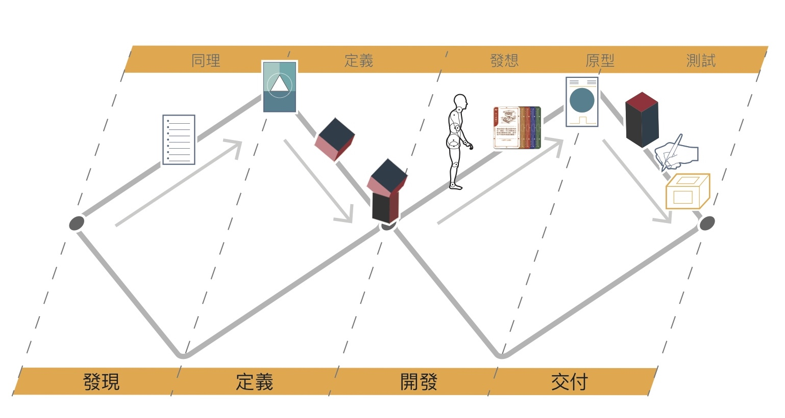
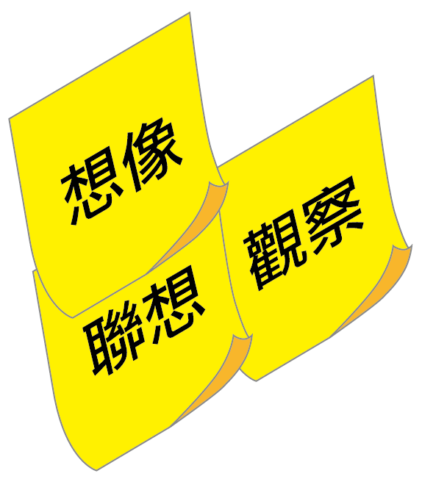
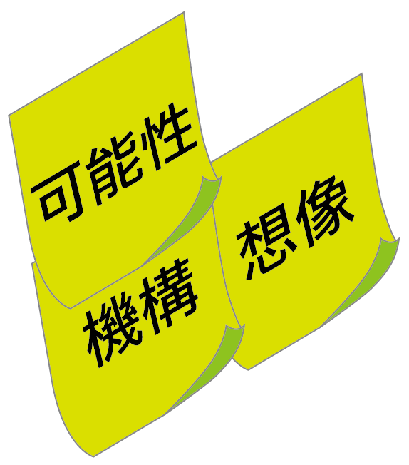
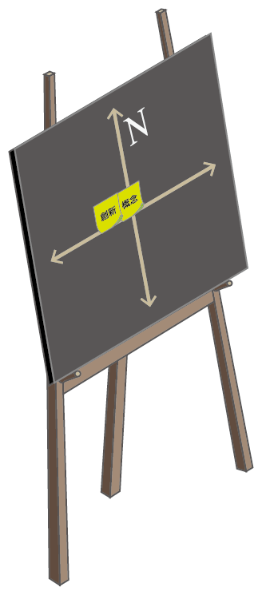
MIAOPU tools
Empathize
Define
Ideate
Prototype
Test
KJ Method
Empathy Map
Cross Analysis
Iceberg Poster
Human Factors
Visualization Tools
Focused Hexahedron for Prototyping
(Fang Da-Chang)
Convergent Hexahedron
(Fang Da-Tong)
Prototype Development
Poster
Practical Manuals
(3D Printing / Carpentry / Metalworking)
Design Beacon
Prototype Cards
Prototype Aesthetic Feature Cards
Prototype Aesthetic Value Map
User Matrix
Relevant Benchmark Function Cards
Innovation Flip Matrix
New Compass Rose
Discover
Define
Develop
Deliver
Notes:
This page is about the distribution of interdisciplinary design thinking teaching tools developed by the central office. Here's a brief introduction or a replacement with design thinking tools you have used in the past:
KJ Method
Empathy Mapping
Cross Analysis
Iceberg Poster
Convergent Hexahedron (by Fang Da-Tong)
5W1H Convergent Hexahedron Tool (Design Beacon)
Human Factors Visualization Tools
Prototype Cards
Prototype Development Poster
Focused Hexahedron for Prototyping (Fang Da-Chang)
3D Printing Manual and Debugging Map
Carpentry, Metalworking, Welding Basic Manuals
Aesthetic Feature Cards for Prototypes
Aesthetic Value Mapping for Prototypes
User Matrix
Functional Cards for Related Benchmarks

Slide 18
To implement the five steps of design thinking in a interdisciplinary workshop
Teaching Objectives: To guide students in understanding the design thinking methodology, implementing the design thinking steps, enhancing their interdisciplinary collaboration experience, developing problem definition and problem-solving abilities, and becoming interdisciplinary talents with innovative and entrepreneurial spirit.

Slide 19
The characteristics of a interdisciplinary workshop
Dual instructors
Led by dual instructors, where Teacher A presents questions and scenarios, and Teacher B guides solution skills. Learning involves different domain thinking patterns, observation, analysis, and problem-solving.
Real-world issue
The workshop theme is derived from real-world practical issues in society, emphasizing project-based learning. It allows students to enter real-world scenarios and personally go through the "problem definition-solving" process, fostering their ability to think critically and creatively in an open and uncertain environment.
Diverse students
Students come from different schools and departments, and they need to quickly transition from being strangers to working together to create and develop solutions.
Hands-on work
Cultivate a culture of practicality through hands-on experiences, user research, concept ideation, prototype development, and validation.
Micro-credit course 18 hours (2 full days). Equivalent to one credit. Offered on weekends or during winter and summer breaks with a short-duration, high-efficiency course design. The pace is very intensive.

Slide 20
The preparation process for the interdisciplinary workshop
STEP 1: Determine the theme
Workshop topics can be based on unresolved issues in society or industry, such as "How to make the home life of the elderly more convenient and comfortable?"
STEP 2: Teachers collaboration
Composed of two teachers from different fields, one providing methods or contexts for defining problems, such as observation, experience, or interviews, while the other offers methods for problem-solving, such as space design or product design. Both teachers should communicate their roles and responsibilities thoroughly.
STEP 3: Course planning
Initiate the workshop at least 2 months before and schedule at least 3 curriculum planning meetings to establish rapport, decide on the theme, refine the content, and review the details.
STEP 4: Assistant training
TA play a crucial role, including ensuring the smooth operation of the course, facilitating communication and collaboration among students, assisting instructors, and more. TA training should be conducted in advance.
STEP 5: Course execution The execution phase can be divided into three groups: the teacher team, the TA team, and the administrative team, responsible for curriculum planning and teaching, assisting with teaching materials and tools, enrollment promotion, administrative matters, etc.

Slide 21
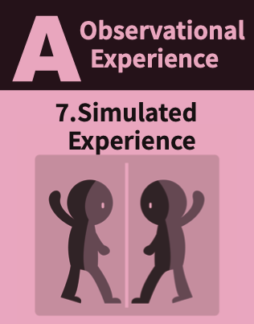
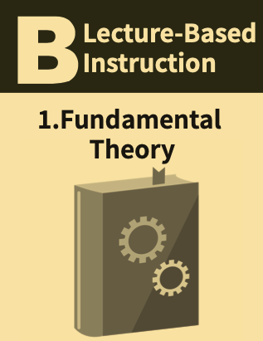
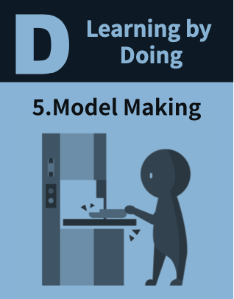
Teaching methods in interdisciplinary workshops
To stimulate learning outcomes in various stages of design thinking, interdisciplinary workshops incorporate at least four teaching methods throughout the two-day workshop curriculum:
Understanding users, cultivating empathy
Providing subject knowledge, building a foundation
Facilitating interaction and brainstorming by cross disciplinary teams
Prototyping and collaborative problem-solving

Slide 22
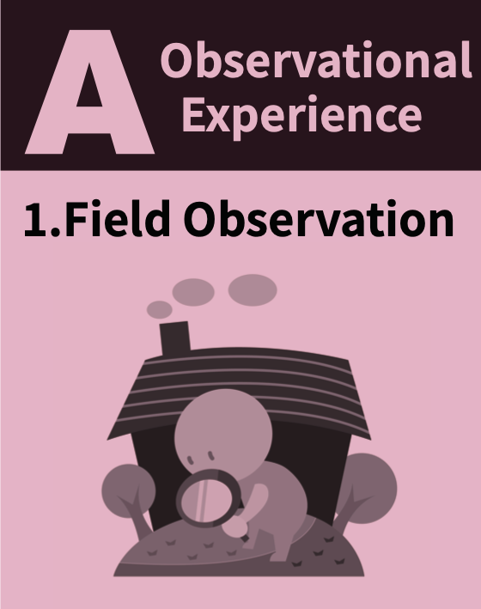
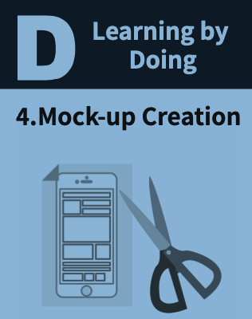
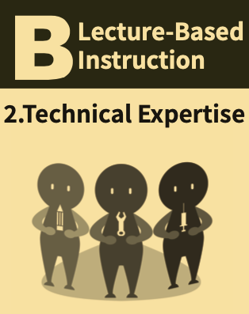
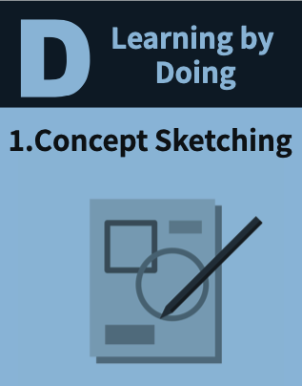
Interdisciplinary workshop schedule planning suggestions
Day 1
time | Recommended agenda
08:30~ | Registration/Introduction | Instructor A
09:00~ |  | Instructor A
12:00~ | Lunch
13:00~ |  | Instructor B
16:00~ |  | Instructor A/B
17:00~
Weekdays
Homework
Day 2
time | Recommended agenda
09:00~ |  | Instructor A/B
12:00~
13:00~ |  | Instructor A/B
16:00~ |  | Instructor A/B Expert Evaluation
17:00~

Slide 23
Types of Interdisciplinary Workshops Operations
X-Type
Workshop
Y-Type
Workshop
Empathy + Problem Definition + Ideation of Solutions
Ideation + Prototype + User Testing
Discover
Define
Develop
Deliver
Transform the design thinking five-step process into two types of workshops: X-Type for the first three steps and Y-Type for the last three steps. Focus on practical exercises related to these three steps and conduct the workshops over two days for instruction.

Slide 24
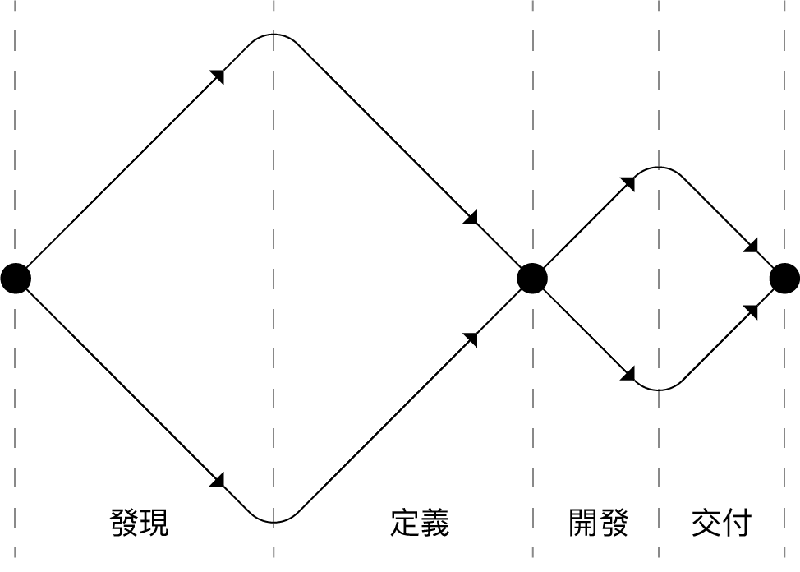
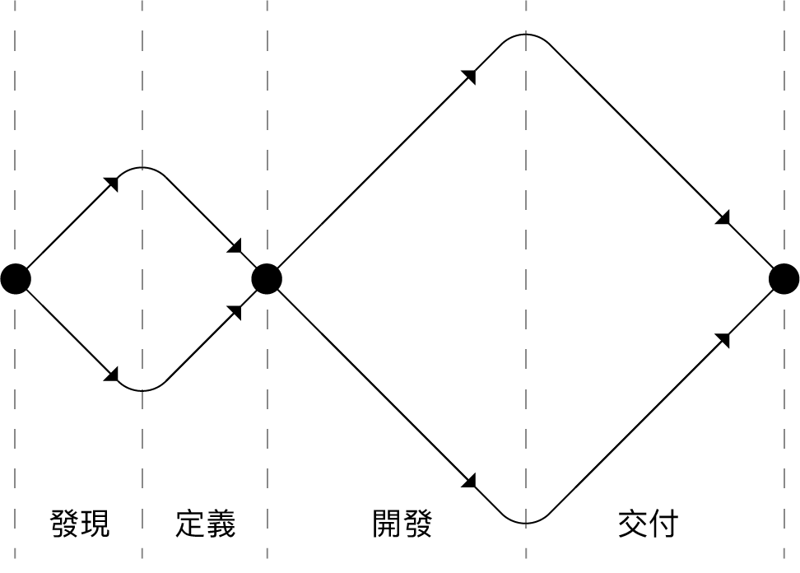
Course implementation
Discover
Define
Develop
Deliver
Discover
Define
Develop
Deliver
X-Type Workshop
Y-Type Workshop
Notes:
Emphasizing that the two-day workshop must be outcome-oriented as a reference for verifying learning, so the terms X-type and Y-type are just considerations of the weight and outcome format of the course within the double diamond process.

Slide 25
Interdisciplinary Workshop: X-Type
Empathy + Problem Definition+ Ideation of Solutions
Discover
Define
Develop
Deliver
Emphasize "problem exploration" and "observing experiences”. Take into real-world settings, empathize with users, explore the potential needs, and converge to define "specific and meaningful" problems through clarification, then generating creative solutions.

Slide 26
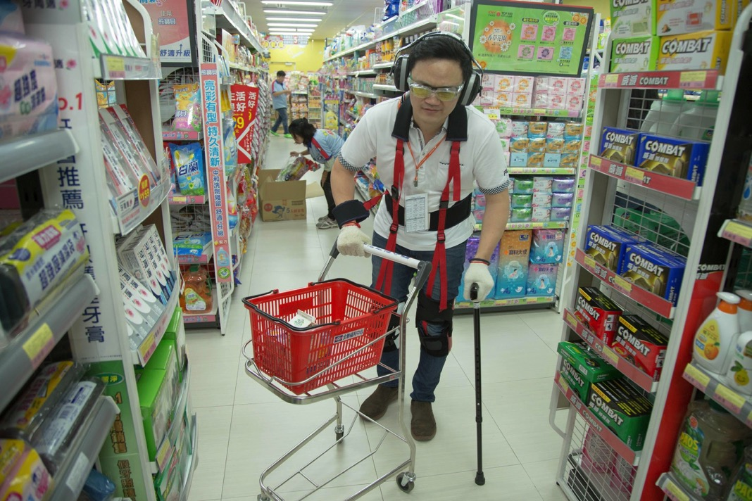
Processing Time:
104.8.26~27.
Processing Location:
National Taiwan University
PX Mart
(Li Yuan Store)
Organizing Unit:
Smart Ageing Alliance
X-Type Workshop Case: Elderly Shopping × Mobile Intelligence.
Notes:
X Silver-haired Shopping X Mobile Intelligence. 104.08.26. 104.08.27
Y1 Brain Power Boost X Silver-haired Technology.102.04.27. 102.05.04
Y2 Brain Activation X Silver-haired Technology.103.05.17. 103.05.24

Slide 27
Theme Ideation
Aging is an inevitable journey in life,
Don't fear it as a problem, but embrace it as the opening of opportunities.
How can we, when we grow old,
Enjoy a new life and experience different lifestyles?
Let's rethink through shopping,
Is the marketplace in life just a place to buy things?
Could it possibly be a channel for learning new knowledge?
A venue for interpersonal communication?
An opportunity to invigorate the mind and body?
Through design, let's redefine Shopping!

Slide 28
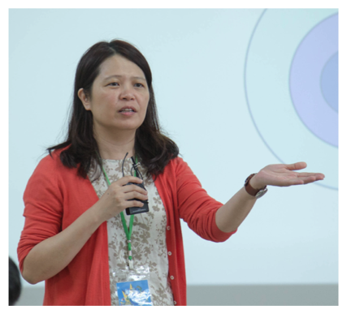
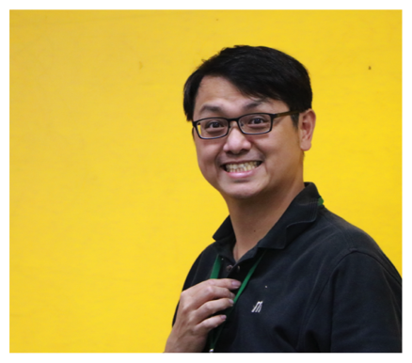
X-Type Case Study: Elderly Shopping × Mobile Intelligence.
Real Issue
Aging Society
Practical Project
Elderly-friendly Shopping Solution
Real-world settings
Shopping Mall/PX Mart
Student
27 participants, divided into four groups.
This includes 22 students from 11 departments; and 5 professionals from various industries, including doctors, architects, and occupational therapists.
Dual Instructors
×
National Taiwan University's Department of Civil Engineering
康仕仲
Shih-Chung Jessy Kang
National Taiwan University's Department of Occupational Therapy 毛慧芬
Hui-fen Mao
Notes:
Cases can be substituted with past experiences.

Slide 29
X-Type Case: Elderly Shopping × Mobile Intelligence
Day 1 104/08/26 (Saturday) |  |  | Day 2 104/08/27 (Saturday)
08:30~ | Registration/Introduction | Instructor | 08:30~ | Registration | Instructor
09:00~ | Topic Lecture I Understanding the Physical and Mental Changes in the Elderly. | 毛慧芬 | 09:00~ | Clarifying Needs Interview elderly on shopping experiences (Invited four seniors/elderly individuals). | 毛慧芬 康仕仲
09:30~ | Observation Experience Aging Simulation and Store Interviews. | 毛慧芬 康仕仲
12:30~ | Lunch |  | 12:00~ | Lunch
13:30~ | Topic Lecture II Introduce elderly design cases. | 康仕仲 | 13:00~ | Design Development II Elderly-friendly shopping solution | 毛慧芬 康仕仲
15:00~ | Design Development I Brainstorming on elderly shopping issues. | 毛慧芬 康仕仲 | 15:30~ | Final Report Feedback from store managers and the elderly | 毛慧芬 康仕仲
17:00~ | Conclusion |  | 17:00~ | Conclusion
Notes:
Cases can be substituted with past experiences.
The class schedule is very important.

Slide 30
X-Type Case: Elderly Shopping × Mobile Intelligence
Day 1 104/08/26 (Saturday) |  |  | Day 2 104/08/27 (Saturday)
08:30~ | Registration/Introduction | Instructor | 08:30~ | Registration | Instructor
09:00~ | Topic Lecture I Understanding the Physical and Mental Changes in the Elderly. | 毛慧芬 | 09:00~ | Clarifying Needs Interview elderly on shopping experiences (Invited four seniors/elderly individuals). | 毛慧芬 康仕仲
09:30~ | Observation Experience Aging Simulation and Store Interviews. | 毛慧芬 康仕仲
12:30~ | Lunch |  | 12:00~ | Lunch
13:30~ | Topic Lecture II Introduce elderly design cases. | 康仕仲 | 13:00~ | Design Development II Elderly-friendly shopping solution | 毛慧芬 康仕仲
15:00~ | Design Development I Brainstorming on elderly shopping issues. | 毛慧芬 康仕仲 | 15:30~ | Final Report Feedback from store managers and the elderly | 毛慧芬 康仕仲
17:00~ | Conclusion |  | 17:00~ | Conclusion
Notes:
Cases can be substituted with past experiences.

Slide 31
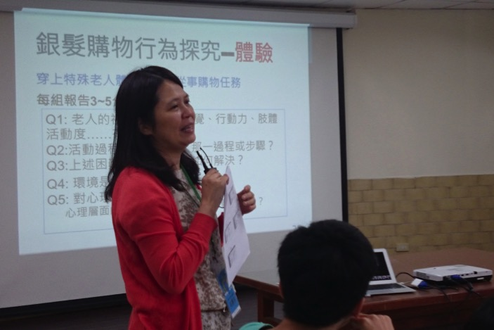
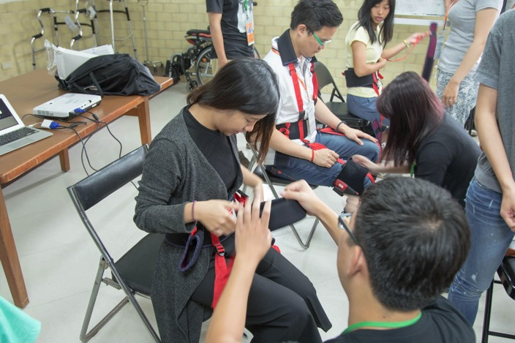
X-Type Case: Elderly Shopping × Mobile Intelligence
104.8.26 9:00 Taipei City Library Daan Branch (above the PX mart Liyuan Store).
Empathy: Theme-based instruction, teacher explained the physical and mental changes in the elderly, and the shopping behaviors of the elderly generation. By utilizing aging experience suits, it allowed younger students to better understand and care about the lives of the elderly.
Notes:
Cases can be replaced with past experiences.

Slide 32
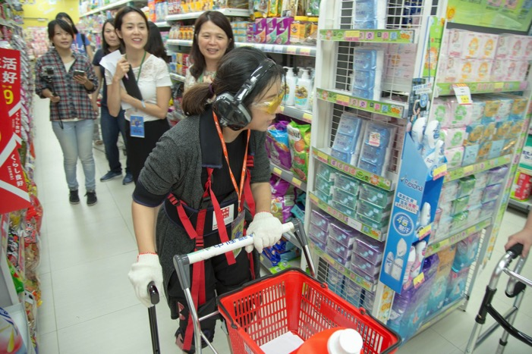
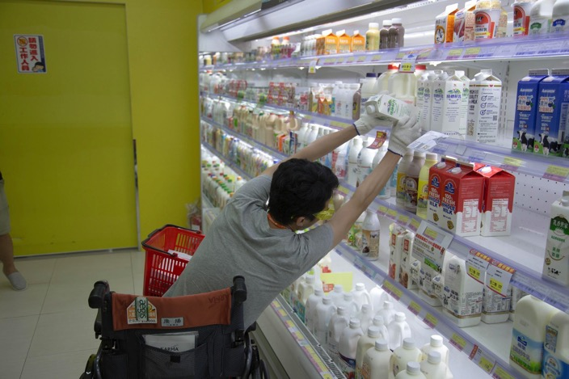
X-Type Case: Elderly Shopping × Mobile Intelligence
104.8.26 9:30 PX mart Liyuan Store
Empathy: By utilizing observational experiences and wearing aging suits, participants entered the shopping store to complete tasks based on a shopping list. All items were to be purchased have been carefully designed by teachers to let participants experience the physical and emotional challenges faced by the elderly, understanding their difficulties.
Notes:
Cases can be replaced with past experiences.

Slide 33
X-Type Case: Elderly Shopping × Mobile Intelligence
104.8.26 10:00 PX mart Liyuan Store
Empathy: Conducted interviews with store clerk. Through the experience sharing of store managers and senior staff, insights were gathered on the shopping habits and service needs of the elderly in the store. This broadened the perspective and serveed as a foundation for proposing age-friendly design solutions.
Notes:
Cases can be replaced with past experiences.

Slide 34
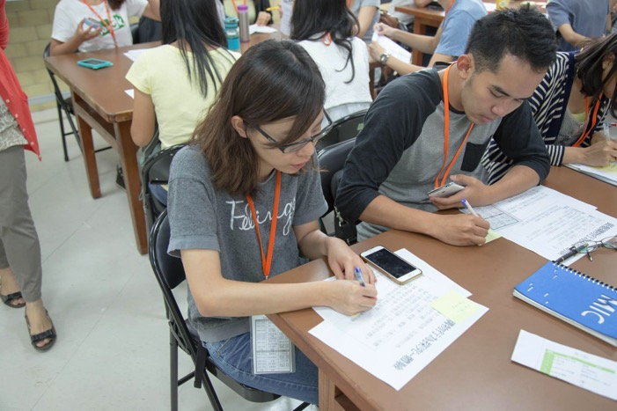
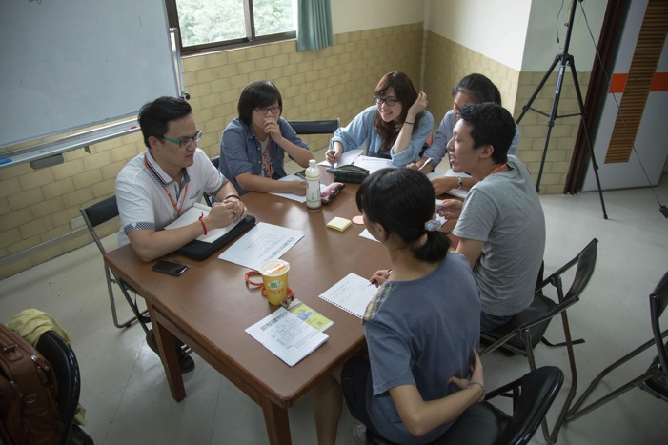
X-Type Case: Elderly Shopping × Mobile Intelligence
104.8.26 11:00 Taipei City Library Daan Branch (above the PX mart Liyuan Store).
Empathy: Group discussion - After shopping experiences and interviews, under the guidance of the teacher, students reflected on and summarized their experiential learning. Within the group, they shared and exchanged various perspectives observed from their respective professional backgrounds.
Notes:
Cases can be replaced with past experiences.

Slide 35
X-Type Case: Elderly Shopping × Mobile Intelligence
Day 1 104/08/26 (Saturday) |  |  | Day 2 104/08/27 (Saturday)
08:30~ | Registration/Introduction | Instructor | 08:30~ | Registration | Instructor
09:00~ | Topic Lecture I Understanding the Physical and Mental Changes in the Elderly. | 毛慧芬 | 09:00~ | Clarifying Needs Interview elderly on shopping experiences (Invited four seniors/elderly individuals). | 毛慧芬 康仕仲
09:30~ | Observation Experience Aging Simulation and Store Interviews. | 毛慧芬 康仕仲
12:30~ | Lunch |  | 12:00~ | Lunch
13:30~ | Topic Lecture II Introduce elderly design cases. | 康仕仲 | 13:00~ | Design Development II Elderly-friendly shopping solution | 毛慧芬 康仕仲
15:00~ | Design Development I Brainstorming on elderly shopping issues. | 毛慧芬 康仕仲 | 15:30~ | Final Report Feedback from store managers and the elderly | 毛慧芬 康仕仲
17:00~ | Conclusion |  | 17:00~ | Conclusion
Notes:
Cases can be replaced with past experiences.

Slide 36
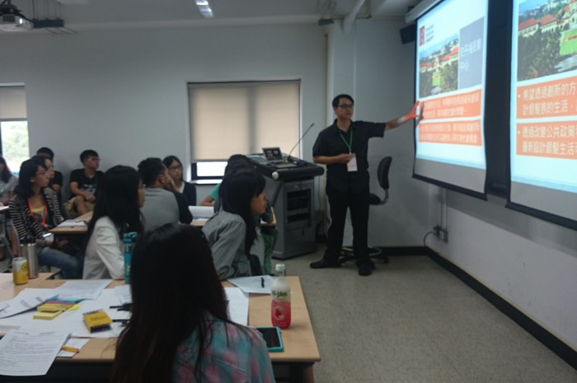
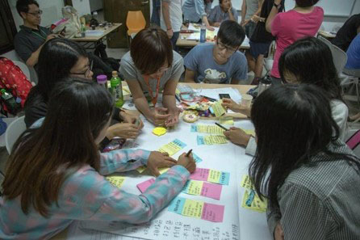
X-Type Case: Elderly Shopping × Mobile Intelligence
104.8.26 13:30 National Taiwan University / Civil Research Building Room 407
Define: Theme-based instruction, introduced innovative cases of elderly design from Taiwan and international cases. It encouraged students to view an aging society as an opportunity rather than a challenge, inspiring their imagination regarding innovative design and expanding their perceptions of shopping and stores. It also guided students in brainstorming and stimulated their creativity.
Notes:
Cases can be replaced with past experiences.

Slide 37
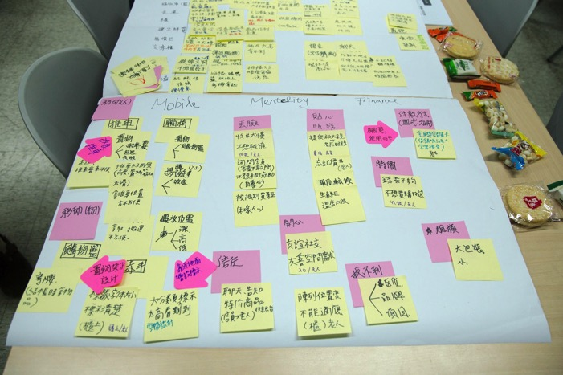
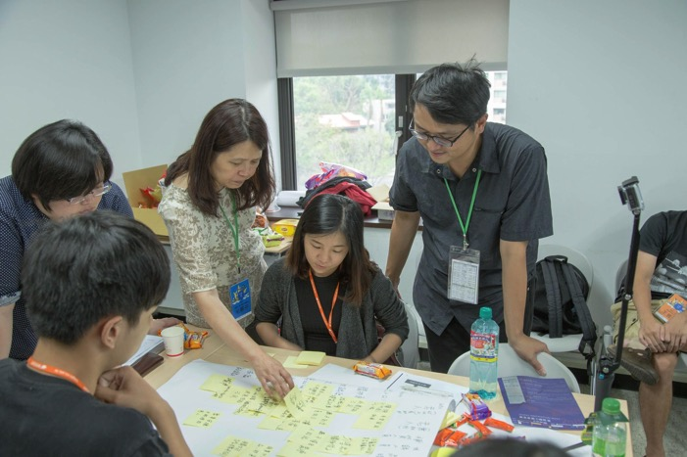
X-Type Case: Elderly Shopping × Mobile Intelligence
104.8.26 15:00 National Taiwan University / Civil Research Building Room 407
Define: Group discussion, first-stage ideation. Facilitated by two instructors working in tandem, this process involved listing the perspectives discovered through experiences and interviews. It encompassed addressing all aspects heard and observed, utilized the KJ method to categorize and summarize them, and then redefined and focused on the identified problems.
Notes:
Cases can be replaced with past experiences.

Slide 38
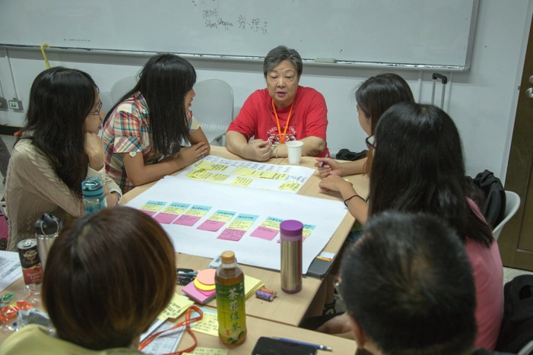
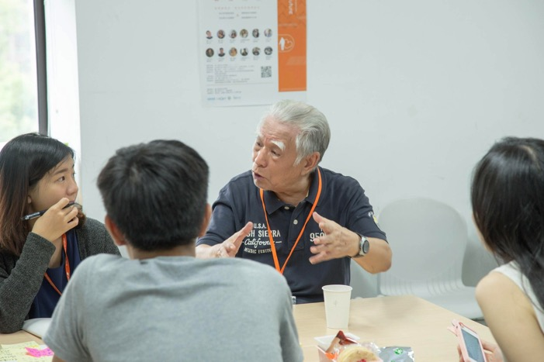
X-Type Case: Elderly Shopping × Mobile Intelligence
104.8.27 09:30 National Taiwan University / Civil Research Building Room 407
Define: On the second day of the workshop, engaged in dialogue and exchange between the elderly and students. Leveraged the experiences and identified needs from the first day, sought the thoughts and suggestions of the elderly individuals, identified 'specific' and 'meaningful' challenges, and transformed them into solutions.
Notes:
Cases can be replaced with past experiences.

Slide 39
X-Type Case: Elderly Shopping × Mobile Intelligence
Day 1 104/08/26 (Saturday) |  |  | Day 2 104/08/27 (Saturday)
08:30~ | Registration/Introduction | Instructor | 08:30~ | Registration | Instructor
09:00~ | Topic Lecture I Understanding the Physical and Mental Changes in the Elderly. | 毛慧芬 | 09:00~ | Clarifying Needs Interview elderly on shopping experiences (Invited four seniors/elderly individuals). | 毛慧芬 康仕仲
09:30~ | Observation Experience Aging Simulation and Store Interviews. | 毛慧芬 康仕仲
12:30~ | Lunch |  | 12:00~ | Lunch
13:30~ | Topic Lecture II Introduce elderly design cases. | 康仕仲 | 13:00~ | Design Development II Elderly-friendly shopping solution | 毛慧芬 康仕仲
15:00~ | Design Development I Brainstorming on elderly shopping issues. | 毛慧芬 康仕仲 | 15:30~ | Final Report Feedback from store managers and the elderly | 毛慧芬 康仕仲
17:00~ | Conclusion |  | 17:00~ | Conclusion
Notes:
Cases can be replaced with past experiences.

Slide 40
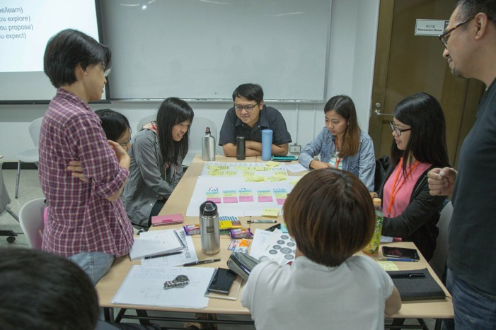
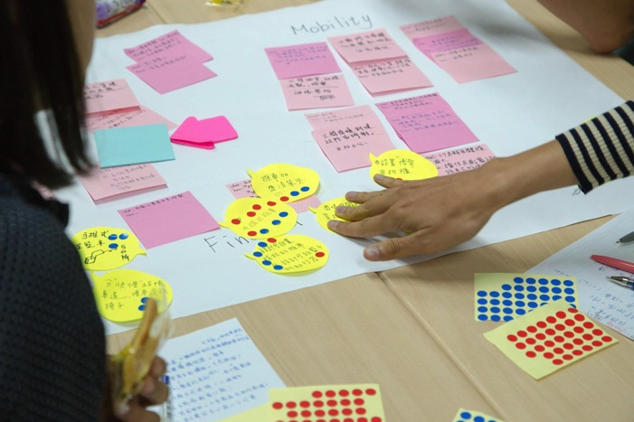
X-Type Case: Elderly Shopping × Mobile Intelligence
104.8.27 13:30 National Taiwan University / Civil Research Building Room 407
Ideate: During the second-stage of ideation in a group discussion, the feedback provided by the elderly individuals sparked a wide range of creative solutions among interdisciplinary team members. Within a limited timeframe, they worked to concretely describe the problems and decide on initial directions.
Notes:
Cases can be replaced with past experiences.

Slide 41
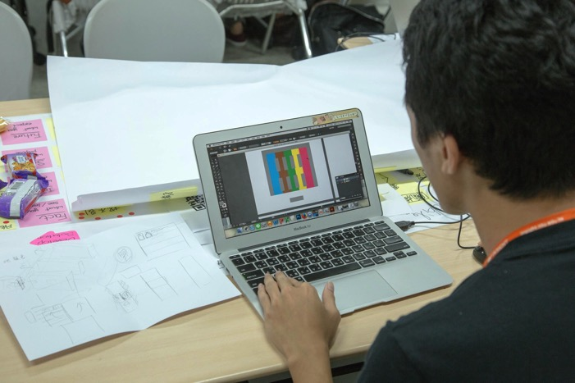
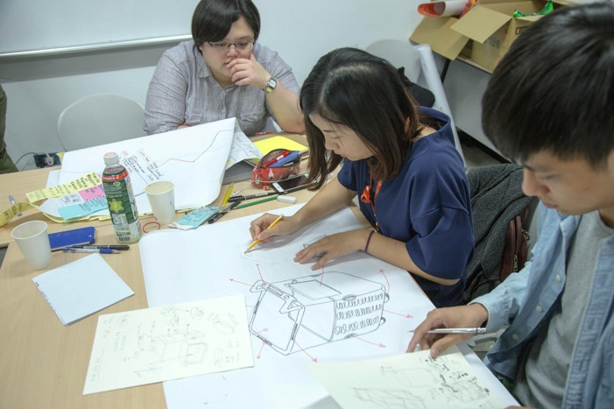
X-Type Case: Elderly Shopping × Mobile Intelligence
104.8.27 15:00 National Taiwan University / Civil Research Building Room 407
Ideate: Hands-on sketching and preparing proposal presentations. In the final stage of the workshop, each group presented project concepts. Participants, under tight time pressure, used rapid drawing and presentation creation to concretely and visually convey their design ideas.
Notes:
Cases can be replaced with past experiences.

Slide 42
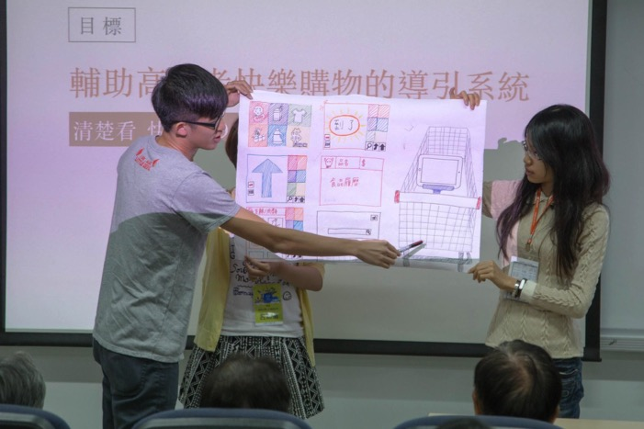
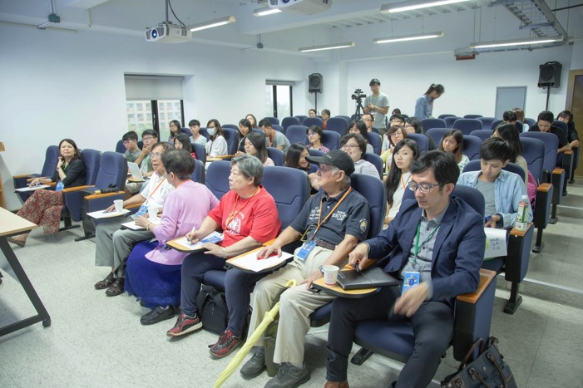
X-Type Case: Elderly Shopping × Mobile Intelligence
104.8.27 16:00 National Taiwan University / Civil Research Building Room 402
Ideate: Project Presentation. Each group presented age-friendly shopping solutions, designing products and services to address the problems identified through observation, experience, and interviews over the course of two days. Evaluations were conducted by elderly individuals and marketing department supervisors from the PX Mart, who provided feedback.
Notes:
Cases can be replaced with past experiences.

Slide 43
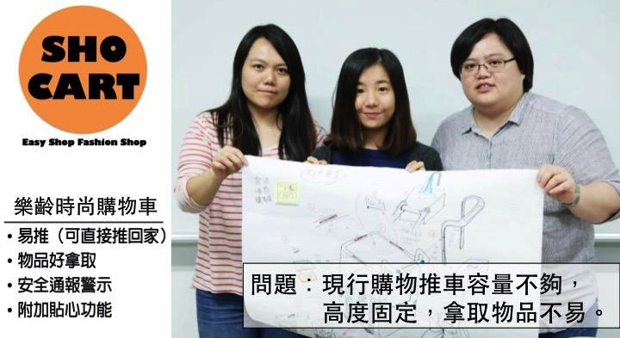
X-Type Case: Elderly Shopping × Mobile Intelligence - Student Project 1
Easy to push (can be pushed directly back home)
Products are easy to pick up
Safety notification and warning
Additional thoughtful features
Issue: The current shopping carts have limited capacity, fixed heights, and are not easy to retrieve products from.
Notes:
Cases can be replaced with past experiences.
The case results are crucial and should serve as an important reference for teachers when envisioning the execution of the curriculum.

Slide 44
X-Type Case: Elderly Shopping × Mobile Intelligence - Student Project 2
Issue: Observing the condition of pushing shopping carts, the shopping list text is too small, the variety of products is overwhelming, signage is too high, and product labels are too small, making it difficult to find products.
Guidance system to assist seniors in enjoyable shopping
Notes:
Cases can be replaced with past experiences.
The case results are crucial and should serve as an important reference for teachers when envisioning the execution of the curriculum.

Slide 45
X-Type Case: Elderly Shopping × Mobile Intelligence - Student Project 3
Internet of Things Interactive Color Labeling
Issue :
Numerous brands, confusing choices
Elderly individuals may wander and have difficulty finding products (cognitive aging)
But they don't want to bother the store staff
Notes:
Cases can be replaced with past experiences.
The case results are crucial and should serve as an important reference for teachers when envisioning the execution of the curriculum.

Slide 46
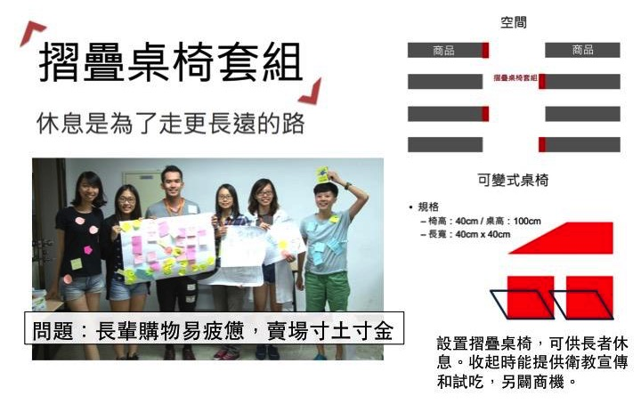
X-Type Case: Elderly Shopping × Mobile Intelligence - Student Project 4
Folding Table and Chair Set
space
commodity
commodity
Folding Table and Chair Set
Resting is for walking a longer journey.
Convertible Table and Chairs
Specification
table height
chair height
Setting up folding tables and chairs for elderly individuals to rest. When folded, they can be used for health education promotion and taste testing, creating additional business opportunities.
length and width
Issue: Elderly shoppers easily fatigued, every square inch of the store is valuable
Notes:
Cases can be replaced with past experiences.
The case results are crucial and should serve as an important reference for teachers when envisioning the execution of the curriculum.

Slide 47
X-Type Case: Elderly Shopping × Mobile Intelligence - Elderly Feedback
Thank you for participating in this workshop today. Your thoughtfulness regarding elderly shopping is greatly appreciated. It's good to have places where both the elderly and children can sit and rest, especially after standing for a long time. Providing a space for taste testing and promotional advertisements is also a great way to attract people from different places and stimulate consumption. Thank you all for contributing many valuable suggestions to help!
Grandpa Mao
Thank you everyone for your dedicated efforts, benefiting the elderly. I'm also grateful for the clear direction provided by PX Mart; it's easy to understand, and I'm very satisfied.
Perhaps shopping carts could offer delivery services. If we forget to bring our carts, we might need to buy them again. Additionally, making the carts foldable for easy carrying could be useful. Stability is crucial for shopping carts; they shouldn't be too lightweight as elderly individuals might trip.
The food product traceability and item search features make things more convenient, which is excellent.
Grandma Mao
Notes:
Cases can be replaced with past experiences.
Feedback and reflection in the course are crucial. They can serve as a reference for teachers when envisioning future interactions between students and the field.

Slide 48
Interdisciplinary Workshop: Y-Type
Ideation + Prototype + User Testing
Discover
Define
Develop
Deliver
Emphasizing 'Problem Solving' and highlighting 'Hands-on Implementation’. Starting from specific problems or specified technologies, diverging into creative possibilities for technology application, rapidly building functional prototypes for demonstration, conducting user testing, and collecting feedback to refine the design.
Notes:
Cases can be replaced with past experiences.

Slide 49
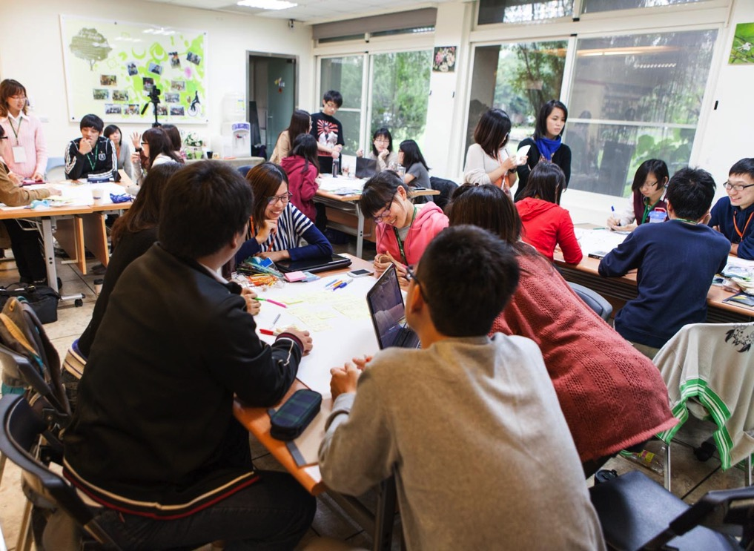
Date and Time:
102.11.24.
102.12.01.
Location:
NTU INSIGHT
Open Lab
Organizer:
Smart Aging Alliance
Y-Type Case: Healthy Food × Emotion-driven Design
Notes:
Cases can be replaced with past experiences.

Slide 50
Theme Ideation
How to eat healthily and happily?
Where nutrition and industrial design meet,
What sparks will fly?
Integrate 'Emotional Design' into 'Nutritional Health,’
so that 'eating' for the elderly is not just an action in life,
but an enjoyment, a pleasure.
Thinking outside the box, let the elderly eat healthily and happily!
Notes:
Cases can be replaced with past experiences.

Slide 51
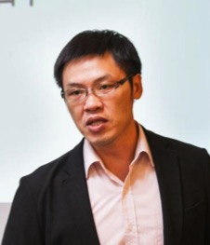
Y-Type Case: Healthy Food × Emotion-driven Design
Real Issues
Dietary needs and challenges of the elderly population, nutritional health
Practical Project
Designing lifestyle dietary support products for the elderly population
Design Methods
Double Diamond, Scenario-based Design
Participants
26 participants, divided into 4 groups. Including students from various fields of study at National Taiwan University, Chang Gung University, Tatung University, and other universities.
Three Instructors
臺北醫學大學保健營養系 楊淑惠
School of Nutrition and Health Sciences, Taipei Medical University
大同工業設計系 楊朝陽
Department of Industrial Design, Tatung University
大同工業設計系 王明旭
Department of Industrial Design, Tatung University
Notes:
Cases can be replaced with past experiences.

Slide 52
Y-Type Case: Healthy Food × Emotion-driven Design
Day 1 102/11/24 (Saturday) |  |  | Day 2 102/12/01 (Saturday)
09:00~ | Introduction | 楊淑惠楊朝陽 | 09:00~ | Testing and Verification with Recording I Walkthrough Testing Capturing Every Scene with Camera | 王明旭 楊朝陽
09:30~ | Topic Lecture I Home Care for Diabetes Patients Patients with Metabolic Syndrome
12:00~ | Lunch |  | 12:00~ | Lunch
13:00~ | Topic Lecture II Emotional Design | 楊朝陽 | 13:00~ | Testing and Verification with Recording II Video Editing and Slide Making | 楊淑惠王明旭 楊朝陽 評審群
14:30~ | Prototype Implementation I Afternoon Theater / Situational Stories | 王明旭 楊朝陽 | 14:00~ | Closing Report Presentation and Expert Feedback
15:30~ 17:00 | Prototype Implementation II Pre-production Video Making |  | 16:00~ 16:30 | Conclusion and Closing
Notes:
Cases can be replaced with past experiences.
The timetable is crucial; teachers should use it as a reference.

Slide 53
Y-Type Case: Healthy Food × Emotion-driven Design
Day 1 102/11/24 (Saturday) |  |  | Day 2 102/12/01 (Saturday)
09:00~ | Introduction | 楊淑惠楊朝陽 | 09:00~ | Testing and Verification with Recording I Walkthrough Testing Capturing Every Scene with Camera | 王明旭 楊朝陽
09:30~ | Topic Lecture I Home Care for Diabetes Patients Patients with Metabolic Syndrome
12:00~ | Lunch |  | 12:00~ | Lunch
13:00~ | Topic Lecture II Emotional Design | 楊朝陽 | 13:00~ | Testing and Verification with Recording II Video Editing and Slide Making | 楊淑惠王明旭 楊朝陽 評審群
14:30~ | Prototype Implementation I Afternoon Theater / Situational Stories | 王明旭 楊朝陽 | 14:00~ | Closing Report Presentation and Expert Feedback
15:30~ 17:00 | Prototype Implementation II Pre-production Video Making |  | 16:00~ 16:30 | Conclusion and Closing
Notes:
Cases can be replaced with past experiences.

Slide 54
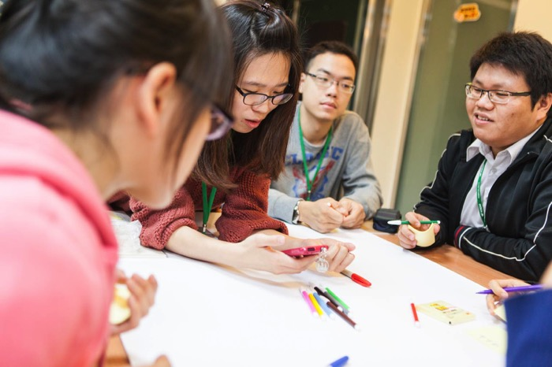
Y-Type Case: Healthy Food × Emotion-driven Design
Ideation: The Y-type workshop places a strong emphasis on hands-on, which aligns with the execution-oriented approach of industrial design. This time, the workshop began with script-based design for scenario ideation, then explored potential user situations through a complete story..
Notes:
Cases can be replaced with past experiences.

Slide 55
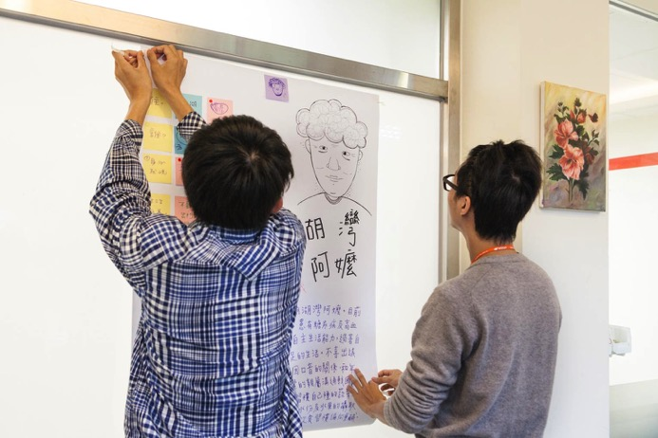
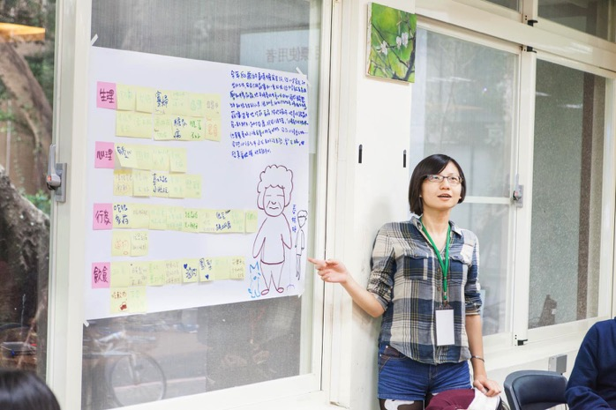
Y-Type Case: Healthy Food × Emotion-driven Design
Ideate: Empathized with the dietary issues and challenges faced by the elderly. With a user-centered design mindset, understood their problems within the context, and rapidly generated user scenarios.
Notes:
Cases can be replaced with past experiences.

Slide 56
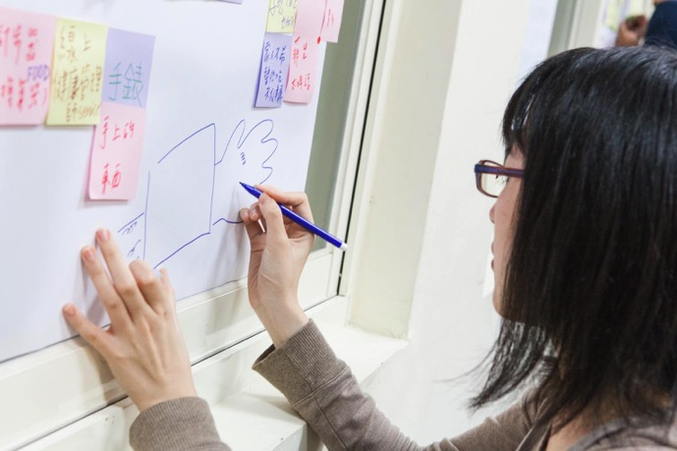
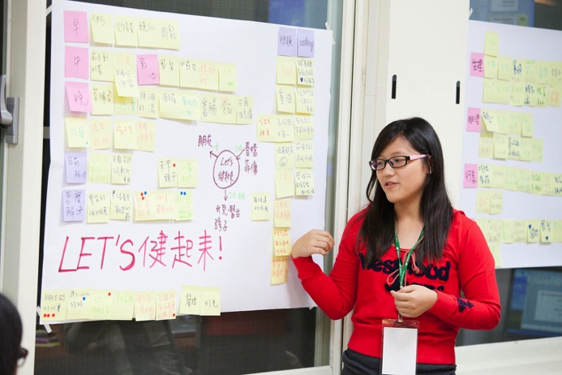
Y-Type Case: Healthy Food × Emotion-driven Design
Ideate: Group discussion and discussions with instructors were conducted to clarify issues and gaps, brainstorming was used to propose solutions, and defined the design of innovative products that solve dietary-related issues for the elderly.
Notes:
Cases can be replaced with past experiences.

Slide 57
Y-Type Case: Healthy Food × Emotion-driven Design
Day 1 102/11/24 (Saturday) |  |  | Day 2 102/12/01 (Saturday)
09:00~ | Introduction | 楊淑惠楊朝陽 | 09:00~ | Testing and Verification with Recording I Walkthrough Testing Capturing Every Scene with Camera | 王明旭 楊朝陽
09:30~ | Topic Lecture I Home Care for Diabetes Patients Patients with Metabolic Syndrome
12:00~ | Lunch |  | 12:00~ | Lunch
13:00~ | Topic Lecture II Emotional Design | 楊朝陽 | 13:00~ | Testing and Verification with Recording II Video Editing and Slide Making | 楊淑惠王明旭 楊朝陽 評審群
14:30~ | Prototype Implementation I Afternoon Theater / Situational Stories | 王明旭 楊朝陽 | 14:00~ | Closing Report Presentation and Expert Feedback
15:30~ 17:00 | Prototype Implementation II Pre-production Video Making |  | 16:00~ 16:30 | Conclusion and Closing
Notes:
Cases can be replaced with past experiences.

Slide 58
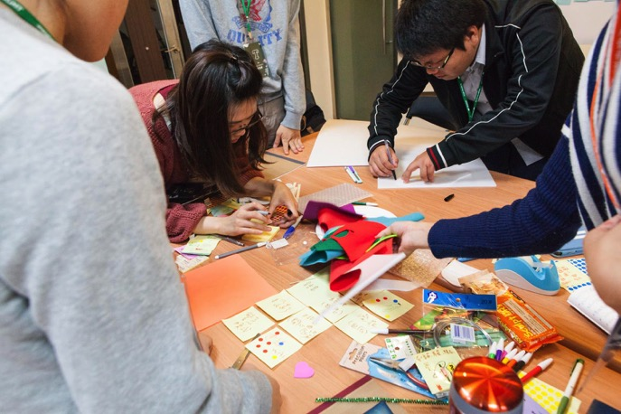
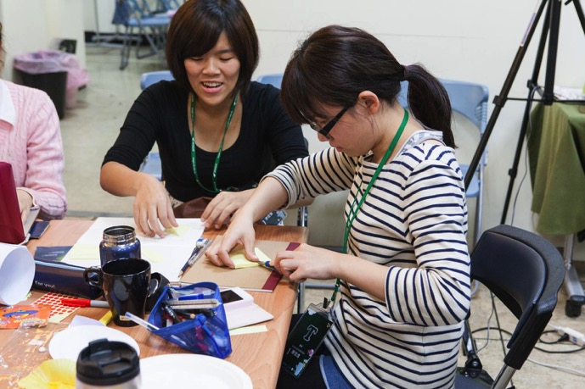
Y-Type Case: Healthy Food × Emotion-driven Design
102.4.27 13:30 National Taiwan University / Civil Research Building Room 405
Prototype: Hands-on, utilized various materials to rapidly create a conceptual model, constructed the product's overall structure, details, and more through additive methods. Through hands-on work, the solution is materialized.
Notes:
Cases can be replaced with past experiences.

Slide 59
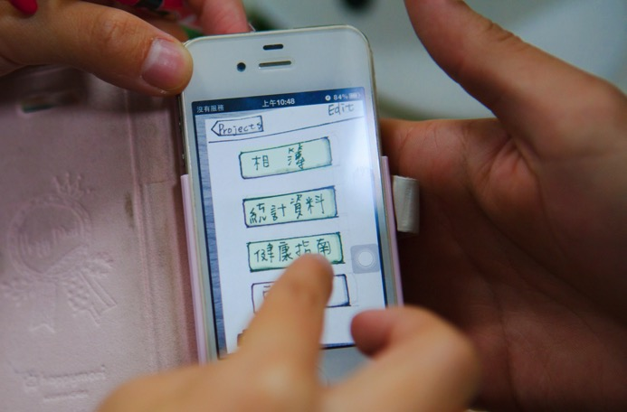
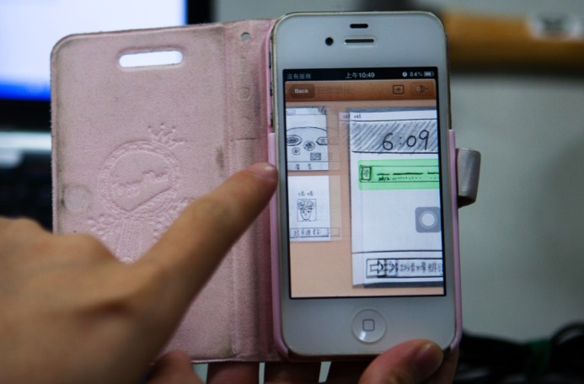
Y-Type Case: Healthy Food × Emotion-driven Design
Prototype: During the production process, as hands-on work and concept organization were put into practice, the use of media became increasingly diverse, getting closer to the user.
Notes:
Cases can be replaced with past experiences.

Slide 60
Y-Type Case: Healthy Food × Emotion-driven Design
Day 1 102/11/24 (Saturday) |  |  | Day 2 102/12/01 (Saturday)
09:00~ | Introduction | 楊淑惠楊朝陽 | 09:00~ | Testing and Verification with Recording I Walkthrough Testing Capturing Every Scene with Camera | 王明旭 楊朝陽
09:30~ | Topic Lecture I Home Care for Diabetes Patients Patients with Metabolic Syndrome
12:00~ | Lunch |  | 12:00~ | Lunch
13:00~ | Topic Lecture II Emotional Design | 楊朝陽 | 13:00~ | Testing and Verification with Recording II Video Editing and Slide Making | 楊淑惠王明旭 楊朝陽 評審群
14:30~ | Prototype Implementation I Afternoon Theater / Situational Stories | 王明旭 楊朝陽 | 14:00~ | Closing Report Presentation and Expert Feedback
15:30~ 17:00 | Prototype Implementation II Pre-production Video Making |  | 16:00~ 16:30 | Conclusion and Closing
Notes:
Cases can be replaced with past experiences.

Slide 61
Y-Type Case: Healthy Food × Emotion-driven Design
Test: Tested the created rough model and documented the usage process through images and photos. Provided feedback on the testing within various scenarios.
Notes:
Cases can be replaced with past experiences.

Slide 62
Y-Type Case: Healthy Food × Emotion-driven Design
Test: After testing, gained a better understanding of the issues encountered during operation, documented the feedback, and edited videos and created presentations to record all the details.
Notes:
Cases can be replaced with past experiences.

Slide 63
Y-Type Case: Healthy Food × Emotion-driven Design
Day 1 102/11/24 (Saturday) |  |  | Day 2 102/12/01 (Saturday)
09:00~ | Introduction | 楊淑惠楊朝陽 | 09:00~ | Testing and Verification with Recording I Walkthrough Testing Capturing Every Scene with Camera | 王明旭 楊朝陽
09:30~ | Topic Lecture I Home Care for Diabetes Patients Patients with Metabolic Syndrome
12:00~ | Lunch |  | 12:00~ | Lunch
13:00~ | Topic Lecture II Emotional Design | 楊朝陽 | 13:00~ | Testing and Verification with Recording II Video Editing and Slide Making | 楊淑惠王明旭 楊朝陽 評審群
14:30~ | Prototype Implementation I Afternoon Theater / Situational Stories | 王明旭 楊朝陽 | 14:00~ | Closing Report Presentation and Expert Feedback
15:30~ 17:00 | Prototype Implementation II Pre-production Video Making |  | 16:00~ 16:30 | Conclusion and Closing
Notes:
Cases can be replaced with past experiences.

Slide 64
Y-Type Case: Healthy Food × Emotion-driven Design
Test: Presentation of findings and expert feedback. After final adjustments and enhancements, each group presented the game machine usage scenarios and targeted cognitive activities. Feedback from the evaluation was used to highlight strengths and identify errors, inspiring students for continuous development.
Notes:
Cases can be replaced with past experiences.

Slide 65
Y-Type Case: Healthy Food × Emotion-driven Design- Project 1: i-Grow
User needs: i-Grow愛國 is an electronic potted plant that grows and blooms according to the health condition of the elderly. Its concept is simple and clear: the potted plant has a voice system that can record family members' voices to regularly remind the elderly to measure their blood pressure, blood sugar, or take medication with signals like "watering" and "fertilizing."
Notes:
Cases can be replaced with past experiences.
Case results are crucial and should serve as an important reference for teachers when envisioning the execution of the curriculum.

Slide 66
Y-Type Case: Healthy Food × Emotion-driven Design - Project 2: Thousand Years Thousand Thousand Years
User needs: 千歲千千歲, inspired by the popular TV series "Legend of Zhen Huan," has designed a "finger-sleeve" styled dietary controller. Its simple operation makes it user-friendly: by just pressing a button and saying, "Today, I ate...," it will connect to a computer system and provide the nutritional index for that meal.
Notes:
Cases can be replaced with past experiences.
Case results are crucial and should serve as an important reference for teachers when envisioning the execution of the curriculum.

Slide 67
Y-Type Case: Healthy Food × Emotion-driven Design – Project 3
User needs: Many elderly individuals lack awareness of healthy eating habits and still enjoy indulging in heavy, rich foods. This product connects a dining table lampshade with a mobile app. During meals, a webcam inside the dining table lampshade activates, capturing images of the dining situation and dishes. Simultaneously, it sends these photos to the children's mobile app, allowing them to monitor their parents' eating habits. This not only promotes proper nutrition but also conveys love and care.
Notes:
Cases can be replaced with past experiences.
Case results are crucial and should serve as an important reference for teachers when envisioning the execution of the curriculum.

Slide 68
Y-Type Case: Healthy Food × Emotion-driven Design – Project 4: Health Promote Cane
User needs: Many elderly individuals struggle to change their habits of consuming heavy, rich foods or lack motivation for physical activity. The “Health Promote Cane" is equipped with a built-in pedometer that assists with walking and accumulates points, encouraging the elderly to walk more. When a certain point threshold is reached, they can even receive free health check-ups at the hospital.
Notes:
Cases can be replaced with past experiences.
Case results are crucial and should serve as an important reference for teachers when envisioning the execution of the curriculum.

Slide 69
Workshop Planning Table
Introduction
Model the Solution
Discussion and Feedback
Aging experience activity
一、Workshop Topic：___×___
二、Course Objectives：
三、Class Start Time and Location：
四、Course Content Introduction
(approximately 100 words)
五、Instructor
A：Define the Problem
B：Solution
六、Target Audience: Undergraduates/
Masters and PhD students
七、Enrollment Capacity: 25 to 30 people
Elderly physical and mental change.
Elderly difficulties and needs.
Elderly products design principles.
Transformation and innovation ideas.
Cut the Model
Homework:
Visit one of the team member's home, take measurements, create a model, and come up with two solutions.
Lecture: Engineering Design Methods Sketch Up Tutorial
Set up the Exhibition
Presentation and Exhibition
Q&A
Sketch Up
Practice
Discussion
Time
Closing Tea Party
Each interdisciplinary workshop is planned for two days, either on alternate weekends or consecutive days, with two teachers throughout the entire session.
Notes:
Cases can be replaced with past experiences.

Slide 70
Summary 1
Design thinking is an effective approach to learning innovation, and it can be put into practice through interdisciplinary workshops.
Characteristics of the Miaopu Interdisciplinary Workshop: Dual instructors, real issues, diverse participants, hands-on experience, micro-credits.
The Miaopu Interdisciplinary Workshop is planned for two days each and encompasses the spirit of the design thinking process, including empathy, define, ideate, prototype, and test.
Notes:
Seed Teacher Training: Three sessions, each from 10:00-17:00. Three Saturdays or during winter break (Monday, Wednesday, Saturday, or three consecutive days). Course Planning (Two days) Teaching Methodologies.

Slide 71
Summary 2
The operation of the Miaopu Workshop can be divided into two types:
X-Type emphasizes 'problem exploration' and 'observational experience'. The main outputs are user research and conceptual proposals for solutions.
Y-Type emphasizes 'problem solving' and 'hands-on practice'. The main outputs are actual verifiable product prototypes.
Whether it's a X-Type or Y-Type workshop, all five steps of design thinking will be covered.
Notes:
Seed Teacher Training: Three sessions, each from 10:00-17:00. Three Saturdays or during winter break (Monday, Wednesday, Saturday, or three consecutive days). Course Planning (Two days) Teaching Methodologies.

Slide 72
教育部跨領域教師發展暨人才培育計畫
此公版簡報特別感謝不斷迭代修正的教練們
苗圃計畫第一期主持人:康仕仲
苗圃計畫第二期主持人:謝尚賢
苗圃計畫第三期教練團參與成員: (排序依筆畫順序排列)
大同大學 工業設計學系 楊朝陽
大同大學 媒體設計系 陳彥甫
中國文化大學 保健營養學系 翁德志
明志科技大學 工業設計系 楊俊明
國立中央大學 網路學習與科技研究所 吳穎沺
國立中央大學 學習與教學研究所 詹明峰
國立中央大學 機械工程學系 蕭述三
國立成功大學 工業設計系 馬敏元
國立成功大學 不分系 李孟學
國立彰化師範大學 企業管理學系 江家瑜
國立臺北商業大學 創意設計與經營所 黃鼎豪
國立臺灣大學 智慧生活科技整合與創新研究中心 賴宏誌
臺北醫學大學 通識教育中心 邱佳慧
臺北醫學大學 跨領域學習中心 王明旭
臺灣科技大學 設計系 董芳武
輔仁大學 創意設計中心 林倩妏
靜宜大學 國際企業學系 顏炘怡
國立臺灣大學 土木工程學系 張鐵懷
感謝歷屆苗圃計畫總辦公室博士後與助理的共同參與
李孟學 蔡孟佳 雲 歡 楊哲玟 陳守晟 張鐵懷 楊琇婷 郭睿駖 蘇倚萱 協助
特別感謝 大同大學 工業設計系助教 傅翊棋 協助公版簡報修正
歡迎使用，請註明出處 design-thinking.tw 以創用CC 姓名標示-非商業性-相同方式分享 3.0 台灣 授權條款釋出。

